Slide 1
The South African Risk and Vulnerability Atlas (SARVA): An open access data
platform
Galaletsang Keebine
South African Environmental Observation Network

Slide 2
Outline
Background
Introduction to SAEON
Introduction to SARVA
SARVA Open Data Architecture
Objectives
SARVA Data and Tools
Users
Linking SARVA to Sustainable Development Goals
Acknowledgement

Slide 3
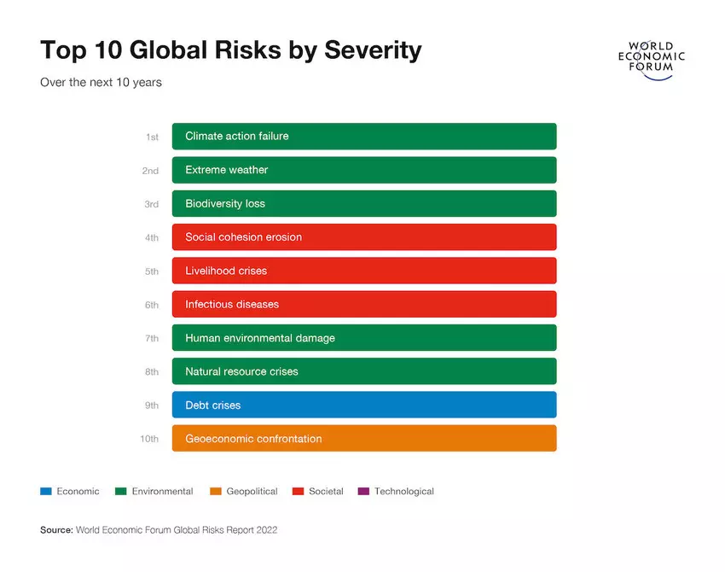
Background
The world is facing a number of complex global challenges that increase the susceptibility of communities to natural and anthropogenic disaster risks.
Globally, climate-related disasters have resulted in approximately US$ 3.6 trillion in economic damages and 2.06 million deaths over the last five decades (WMO, 2021).
In the last five decades, 1695 disasters were recorded in Africa which cost the loss of 731 747 (~36%) lives and US$ 38.5 billion (~1%) economic damages (WMO, 2021).
Generating an enabling environment for communities, governments, and sectors to respond is critical to ensure future resilience.
The ability to profile, track, and monitor the vulnerability of communities will provide insight into their respective socio-economic dynamics and challenges and will contribute to the ability to timeously and pro-actively address potential risks associated with global change.

Slide 4
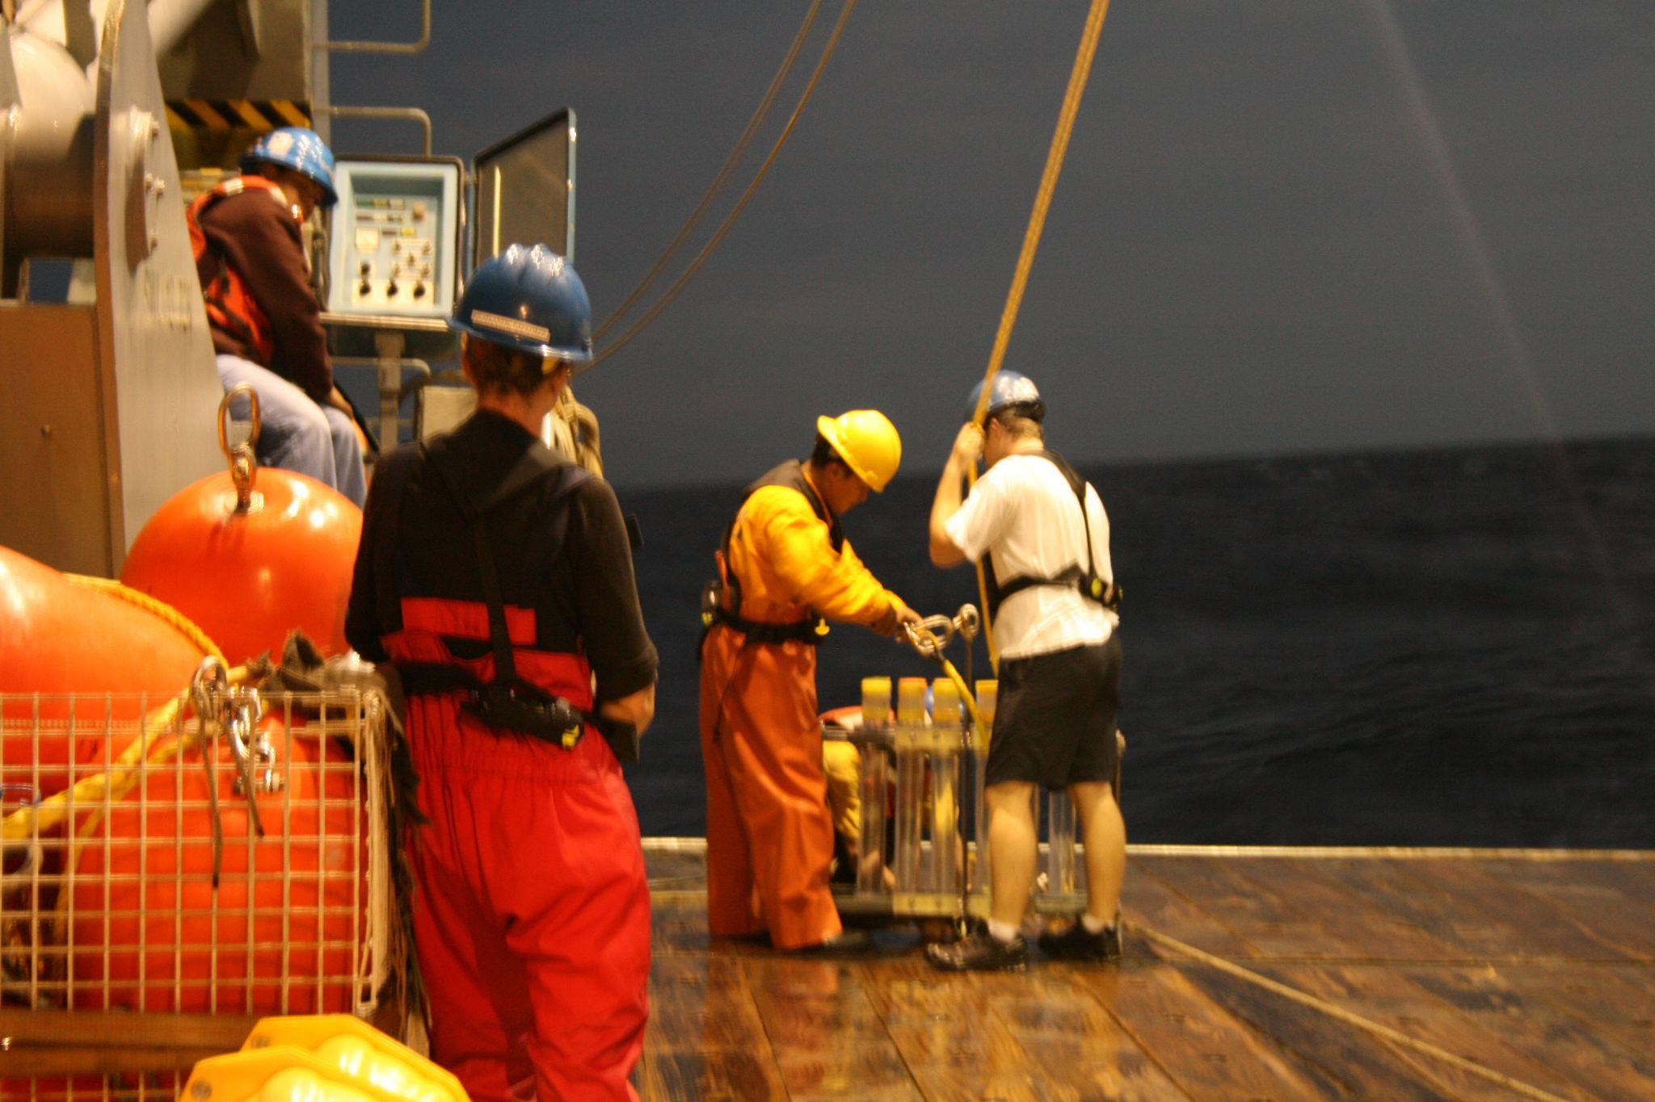
Introduction to SAEON
The South African Environmental Observation Network (SAEON) is a long-term environmental observation and research facility of the National Research Foundation (NRF) funded through South Africa’s Department of Science and Innovation (DSI).
A dedicated function for long-term, in situ Global Change observation research.
SAEON’s vision is to provide “World-class environmental research platforms for a sustainable society”
SAEON has a distributed network of seven nodes and three research infrastructures.

Slide 5
Introduction to SAEON
Focus areas are environmental observation, data management and education outreach.
SAEON hosts a diverse array of sites, instruments, infrastructure, datasets, models and staff distributed across both marine and terrestrial environments, supporting well over 100 researchers and students a year.
Provide detailed in situ data for use as inputs to models, model parameterisation, improved process representation in models
Provides a model for facilitating multi-institutional research, observational equipment, and data management

Slide 6
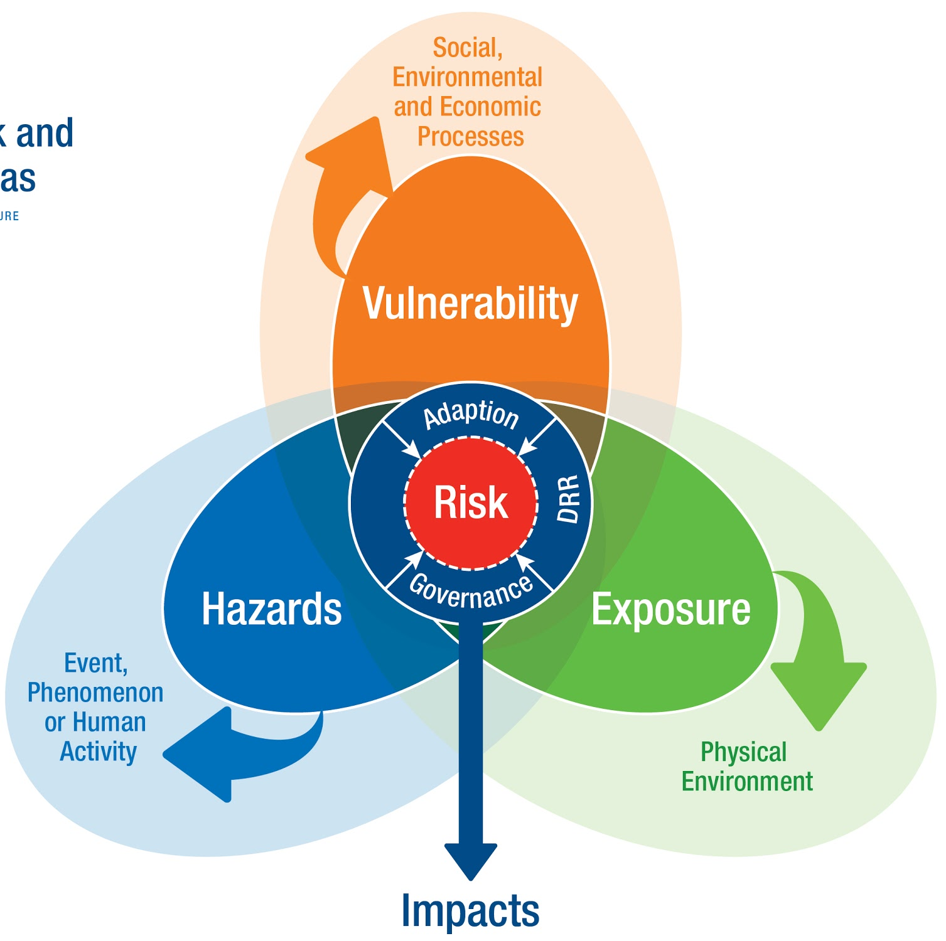
Introduction to SARVA
https://sarva.saeon.ac.za/
The South African Risk and Vulnerability Atlas (SARVA) was initiated in 2008
SARVA is an open access platform that unites data to solve complex interconnected problems.
SARVA is mandated by the DSI to preserve and provide access to global risk data (environmental, societal, economic, technological etc.) for South Africa.
Framework: Risk results from the interaction of vulnerability, exposure, and hazard and refers to the likelihood of an adverse impact from an event.
SARVAs core principles are
ACCESSIBLE: Provides access to scientific data and observations of long-term environmental, societal and economic trends.
USABLE: Translates the data into actionable and impactful information on the risks and vulnerabilities.
RESPONSIVE: Ensures that data and information is based on evolving user needs and changing global challenges or socio-economic dynamics
Risk and Vulnerability

Slide 7
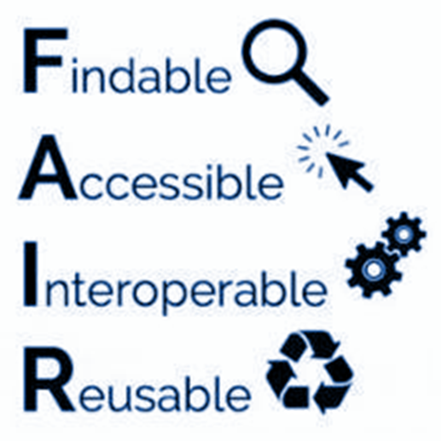
SARVA Open Data Architecture
SARVA relies on infrastructure and open data management system developed by SAEON.
The open data system allows for the publication, discovery, dissemination, visualization and preservation of data.
SAEON’s infrastructure is based on FAIR principles (Findable, Accessible, Interoperable and Reusable) and standardised metadata.
The Open Data Platform (ODP)
Offers the ability to store metadata and datasets in a secure environment
Integrates management of, and access to, a variety of data types, including spatial and time series data, digital content, multidimensional and model data.
Hosts several data portals, including SARVA and SAEON’s own data repository.

Slide 8
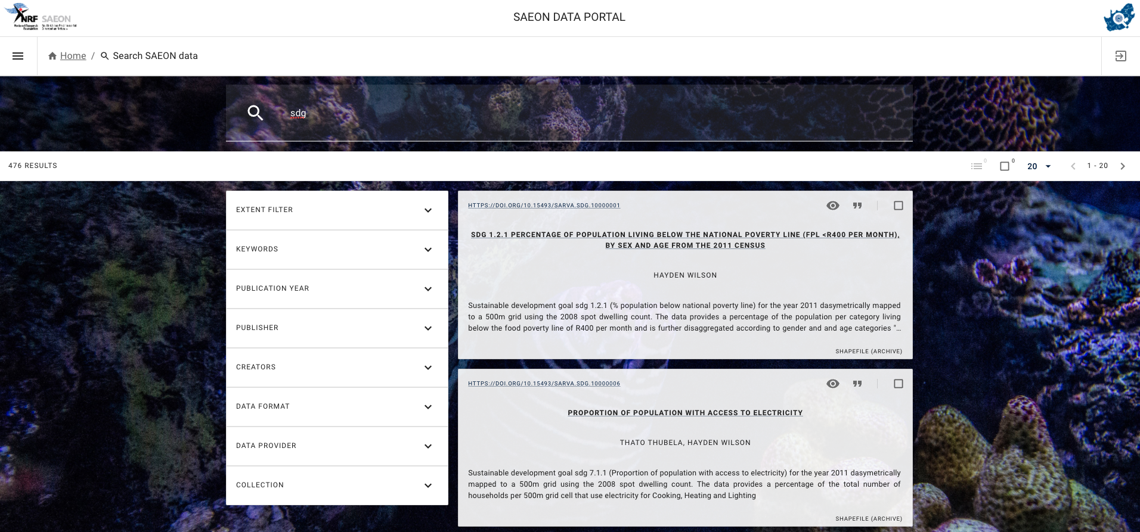
SARVA Open Data Architecture
SAEON Data Catalogue: https://catalogue.saeon.ac.za/

Slide 9
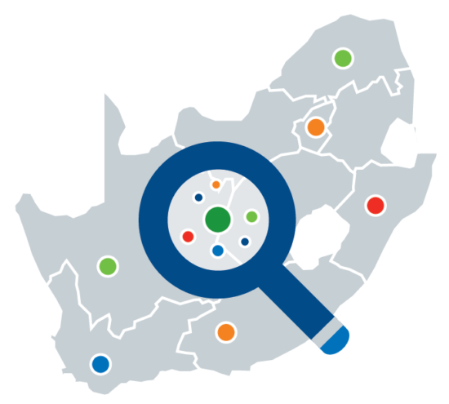
Objectives of SARVA
The objective of SARVA is to proﬁle vulnerability of local municipalities and pro-actively strengthen the ability of the people of South Africa to cope with a range of natural and anthropogenic hazards (including climate change, biodiversity loss, and epidemics).
It aims to equip decision-makers, across the board, with spatial and non-spatial data on impact and risk associated with global change.
Access to data, ultimately place policy and decision makers in a better position to inform effective response measures, intervention strategies, and practices.
Information = decision-ready data, translated into digestible narratives using a range of innovative decision-support tools which include indicator dashboards, infographics, and a searchable atlas.

Slide 10
SARVA Data and Tools
https://sarva.saeon.ac.za/
Designed and reinvested front-end platform with data dashboards and interactive visualisations.
Online searchable catalogue
Online Atlas of climate risk, disasters, air quality, commercial agriculture, environmental vulnerability.
Interactive dashboards (including beta Economics dashboard for South Africa).
Linked district and local level data to 15 out of the 17 SDG goals.

Slide 11
SARVA Data and Tools
SARVA is an open science data portal that provides a single point of access to a growing collection of diverse decision-ready data to solve complex interconnected problems.
SARVA 3.0 focused on data access and value-added products for decision-making that assist municipalities in managing the risks associated with global change.
Global change resources hosted on SARVA include scientific data and long-term observations, static content, references to documentation and reports, and other digital objects.

Slide 12
Users of SARVA
Decision-makers who require information for reporting and planning
Domain experts requiring data for the development of sector-based Atlas’s/ other tools
1
2
Co-Development
4
3
Technical teams/software developers building apps and other decision-support tools
Research community requiring access to data for specific studies.

Slide 13
Linking SARVA to Sustainable Development Goals
SARVA - SDG Dashboard Tool serves as decision support tool for municipal planners to gather data on where their municipalities stand with regard to sustainable development goals.
The indicator datasets which are available in SARVA:
Presented at the highest spatial and temporal resolution possible.
New data is continuously being added to SARVA.

Slide 14
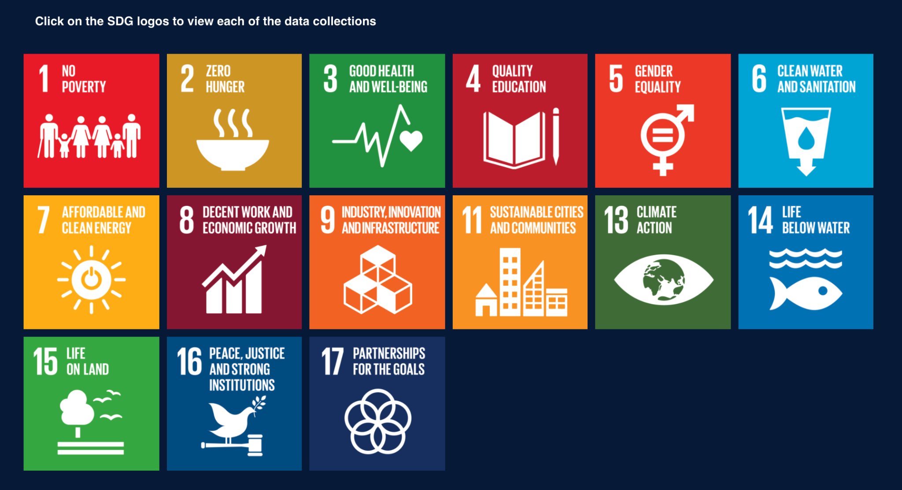

Slide 15
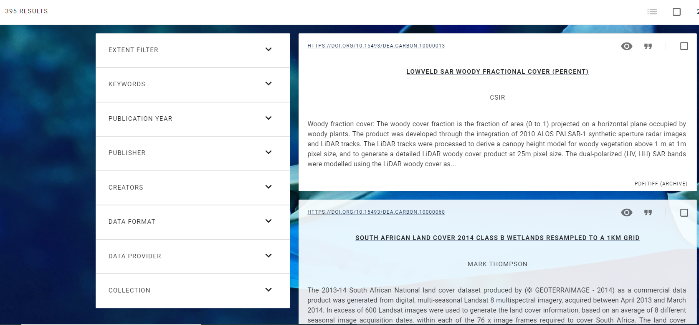
Example: SDG Linked Data

Slide 16
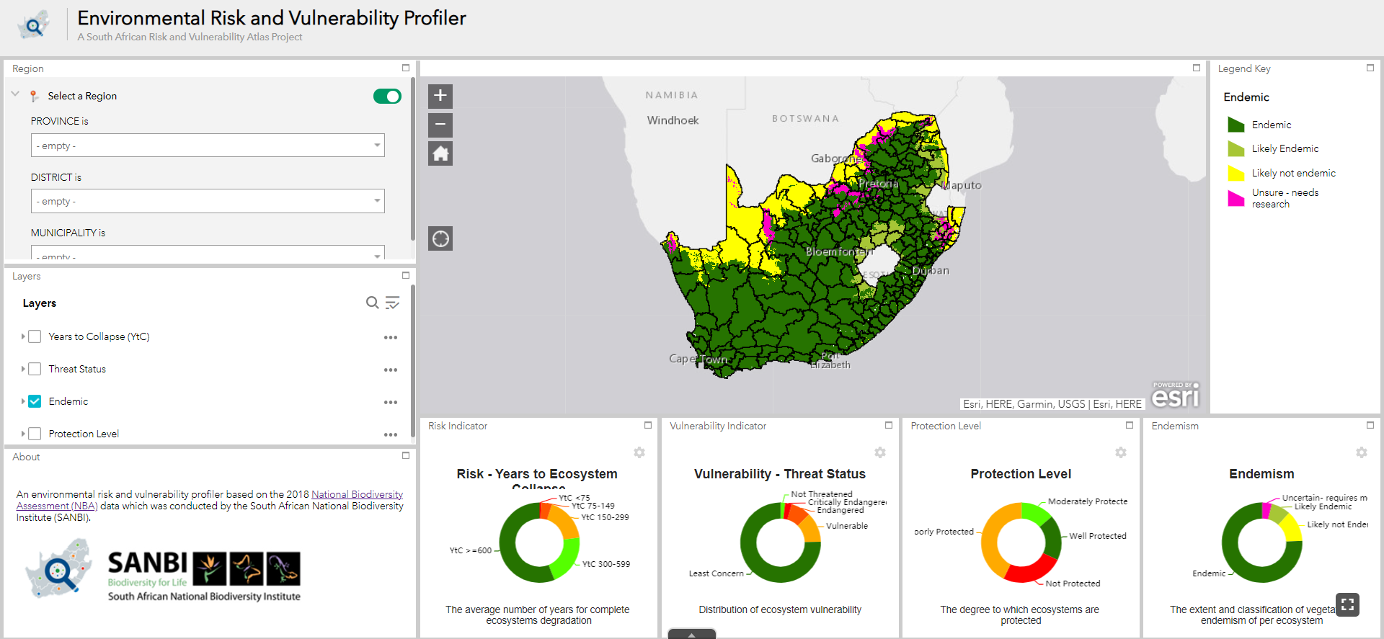
Example: SDG Dashboard

Slide 17
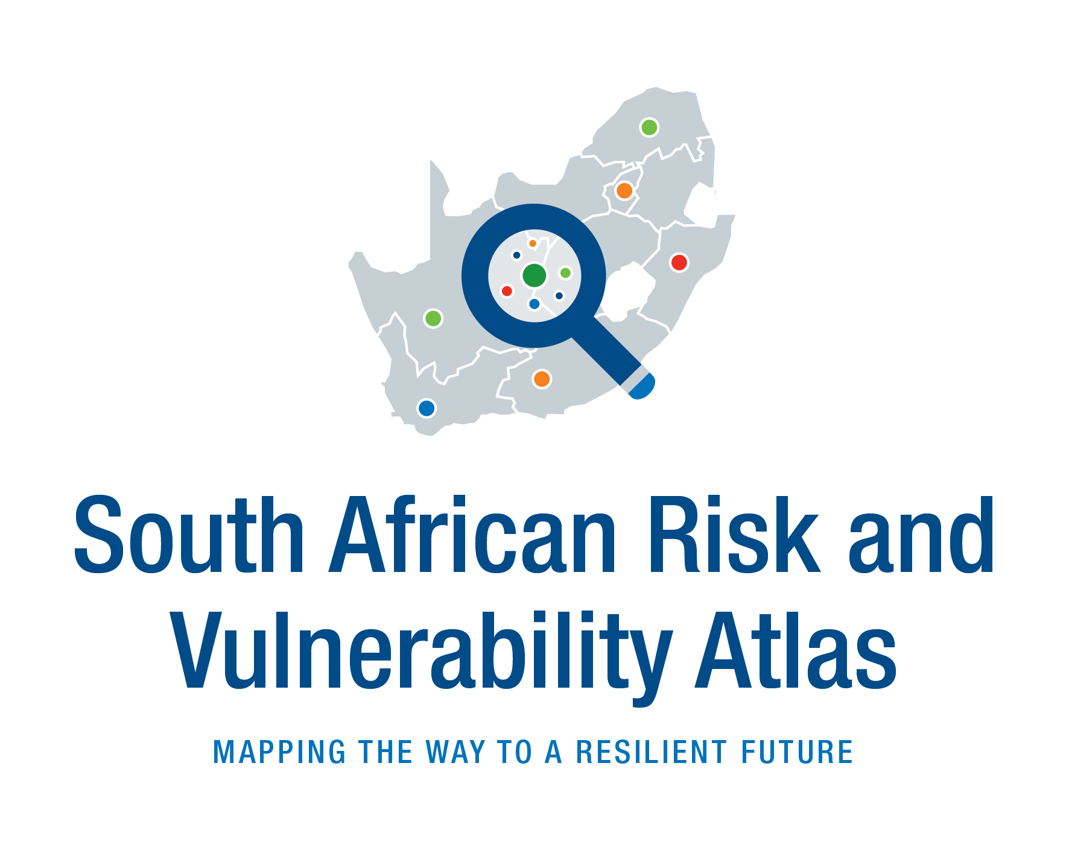
Acknowledgement (Optional)
^{Galaletsang Keebine}
Claire Davis-Reddy
(1) SAEON, South Africa.
(2) SAEON, South Africa.
gl.Keebine@saeon.nrf.ac.za
cl.davisreddy@saeon.nrf.ac.za

Slide 18
Thank you
Questions?

